Slide 1
Four-year Plan for WMO Activities related to Space Weather 2024-2027
Pre INFCOM-3 Information Session
(25 March - 5 April 2024)
Kirsti Kauristie / Chair Expert Team on Space Weather
Jesse Andries / Scientific Officer Space Weather
26 March 2024

Slide 2
General remarks
The session will be recorded, and the recordings will be available on the INFCOM-3 website.
Second part of the session will be dedicated to your questions, please:
- raise your hand,
- use the chat, or
- send an email (in any WMO language) to: jandries@wmo.int.
The working language is English, but we may try to address questions in French.
INFCOM-3 documents: INFCOM-3 - Session Information (wmo.int)

Slide 3
Content
1. Overview of related Documents at INFCOM-3
2. Short history of activities related to Space Weather at WMO
3. Short introduction to Space Weather and its impacts
4. Activities included in the Four-year Plan
5. Interaction with other International Organizations
6. Conclusions
7. Q&A

Slide 4
Related INFCOM-3 Documents
8.1(1) Amendments to WIGOS Manual (WMO-No. 1160) In Session 8.1 Integrated WMO Global Observing System – networks [ Initial inclusion of Observing system for Space Weather; attributes to be included in future updates. ]
8.5(2) Four-year Plan for WMO Activities related to Space Weather 2024-2027 In Session 8.5 Cross-systems

Slide 5
Space Weather at WMO
2024 EC-78 Four-year Plan for WMO activities related to Space Weather 2024-2027
2008 The Potential Role of WMO in Space Weather (SP-5, April 2008) (WMO/TD-No. 1482)
2015 Cg-17 draft Four-year Plan for WMO Activities related to Space Weather 2016-2019
(later adopted at EC-68)
2023 Cg-19
Keep Resolution 53 (Cg-18) in force
2011 Cg-16 Space Weather in RRR
and part of Space Programme
2019 Cg-18 Four-year Plan for WMO activities related to Space Weather 2020-2023
ICTSW
IPT-SWeISS
ET-SWx
WMO Reform
All previous Four-year plans available at ET-SWx website

Slide 6
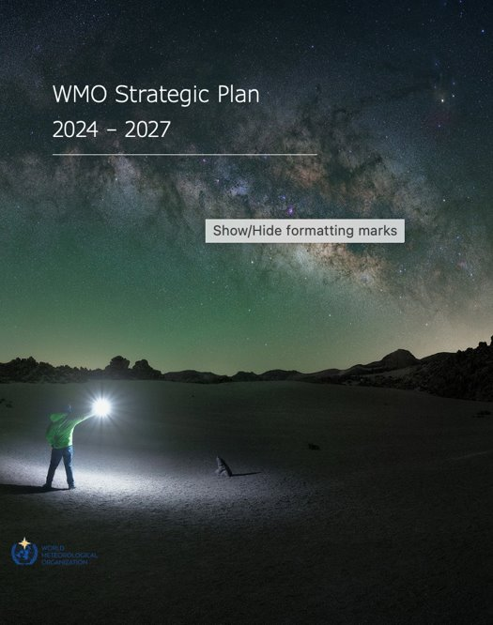
Space Weather is part of WMO Strategic Plan 2024-2027
The physical and phenomenological state of the natural space environment, including the Sun and the interplanetary and planetary environments.
Space Weather is included in multiple WMO activities:
Part of WMO Rolling Review of Observing Requirements since 2011 and an integral part of WIGOS and the WIGOS Vision 2040
Vlab Strategy
Unified Data Policy
Cataloguing of Hazardous events (ET-CHE)
…
But actual integration of Space Weather in WMO regulations and systems
still largely remains to be implemented

Slide 7
Overall content of the Four-year Plan
Update of the previous Four year plans:
Set general aims and objectives:
Data availability to Members
Promote and facilitate development and enhancement of capabilities
Make use of synergies with operational meteorology
Gradual shift from general aims to concrete implementation activities for integration into WMO regulation and systems
Coordination and collaboration with other International Organizations

Slide 8
Short introduction to Space Weather and its impacts
^{wmo.int}

Slide 9
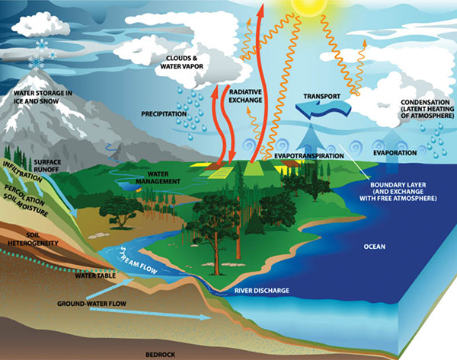
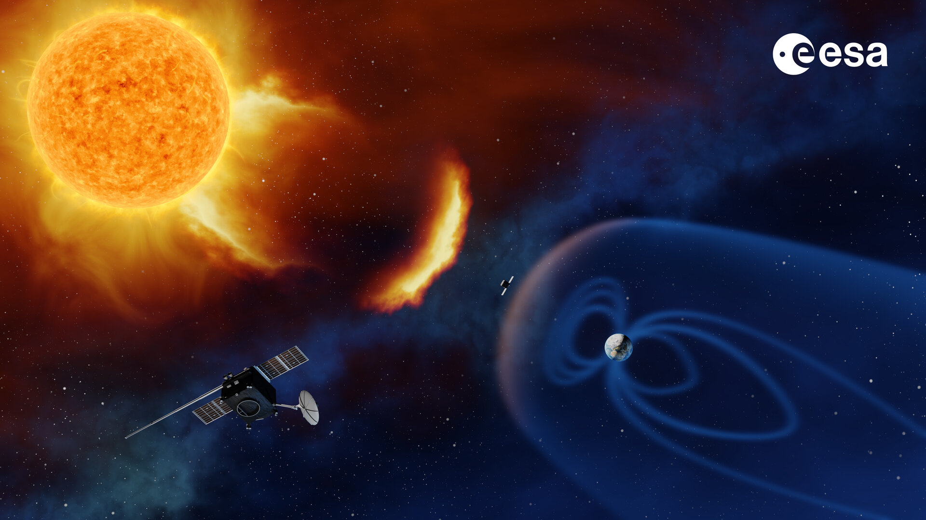
Weather and climate in the atmosphere and space –
Both impacted by interactions between different regimes
Figures: NOAA and ESA

Slide 10
Charged particles (protons) with high energies
Structures in the solar wind that ”shake” the magnetosphere
Bursts of X-rays, EUV and radiowaves

Slide 11
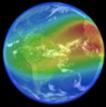
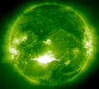
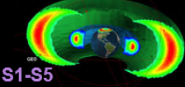
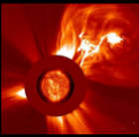
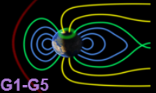
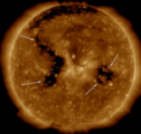
Active region in the Sun
Propagation to the Earth
Physical processes in geospace
Impacts in the technology
X-rays, EUV, Radio waves
Propagation time: 8 min
Duration: 10 min - hours
Disturbances in GNSS, SATCOM, and in radar operations
Problems in HF communication
Ionospheric electron density variations mostly in the dayside
Solar eruption
Energetic particles
Propagation time: tens of min
Duration: hours
Radiation hazards for astronauts, occasionally enhanced radiation at flight altitudes
Charging problems in satellites, ageing of solar panels
Intensification in the energetic particle fluxes, enhanced radiation in near-Earth space and polar cap upper atmosphere
Energetic particles
Propagation time: hours – 4 days
Duration: 1-3 days
Coronal Mass Ejection
Magnetic cloud
Propagation time: 1-4 days
Duration 1-2 days
Geomagnetically induced currents causing problems in power transmission networks
Enhanced satellite drag
Beautiful auroras at mid and low latitudes
Geomagnetic storms causing topology changes in magnetosphere, enhanced ionospheric currents and particle precipitation at auroral oval latitudes
Coronal hole
High speed streams
Coronal Interaction regions
Propagation time: 3-4 days
Duration: 1-4 days
Composed after a similar diagram in Finnish by Tiera Laitinen (FMI)

Slide 12
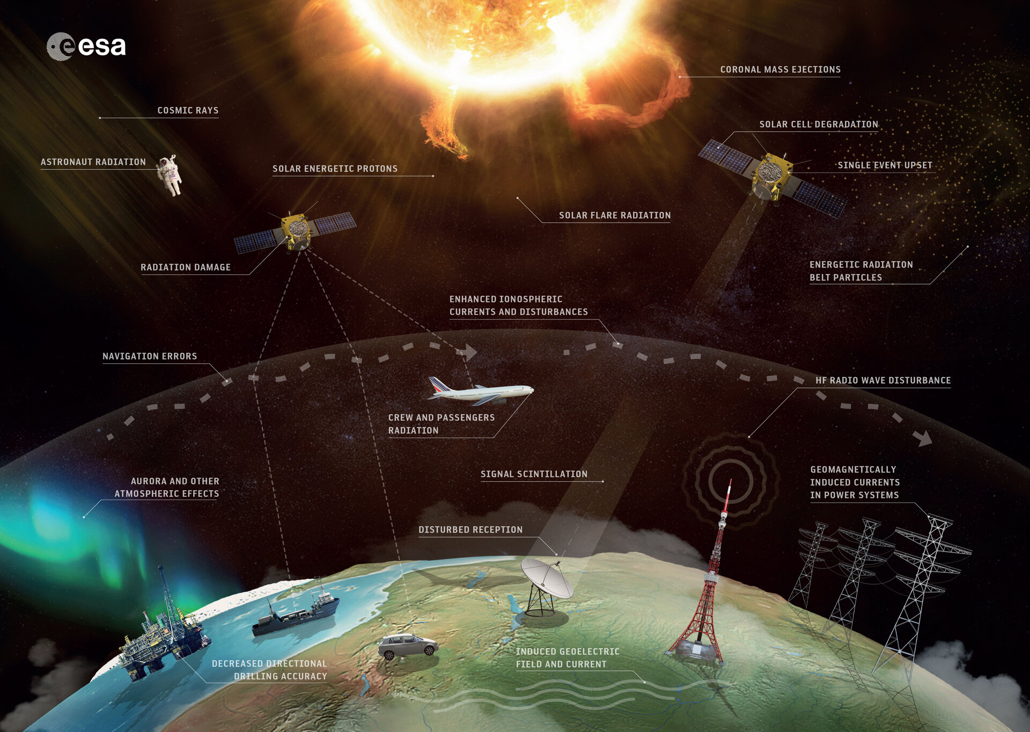

Slide 13
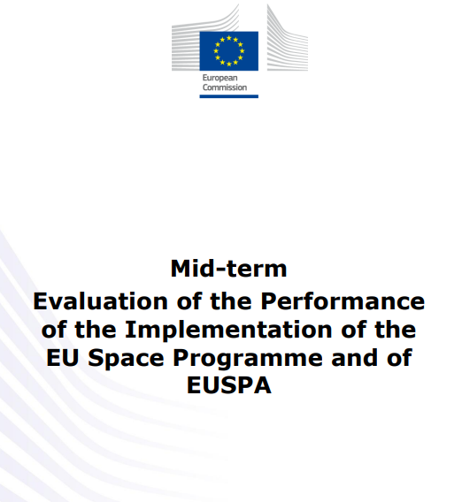
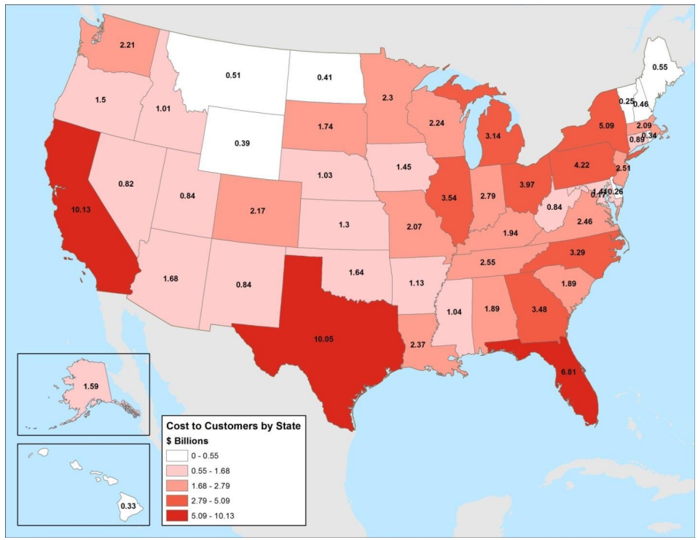
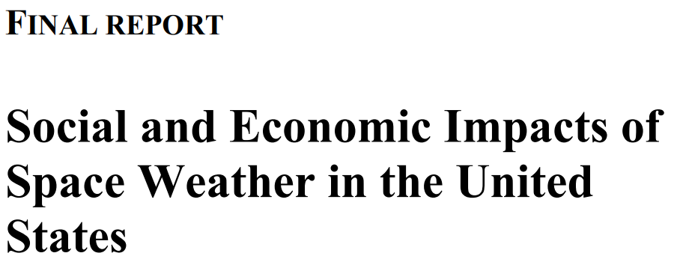
Estimates on the economic impacts of SWx services
The mid-term evaluation of the implementation of European space programme and EUSPA (Nov 2023): ”Economic impact is largest in the areas of power grid and space operations”
ESA Cost-Benefit-Analysis from 2016: “Investing 1 € to space weather services comes back as benefit of 6 € for the society.”
2017

Slide 14
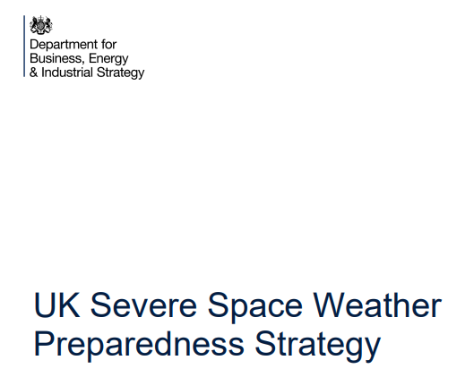
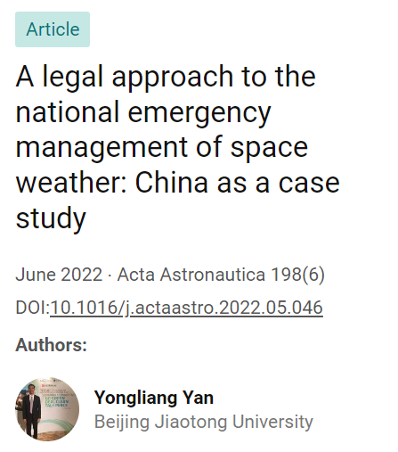
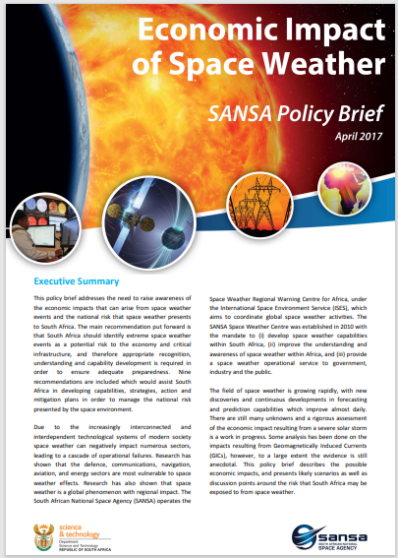
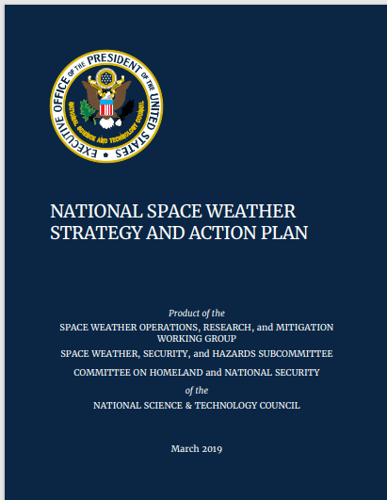
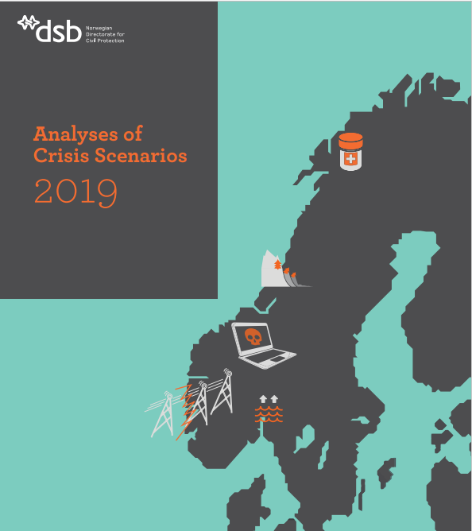
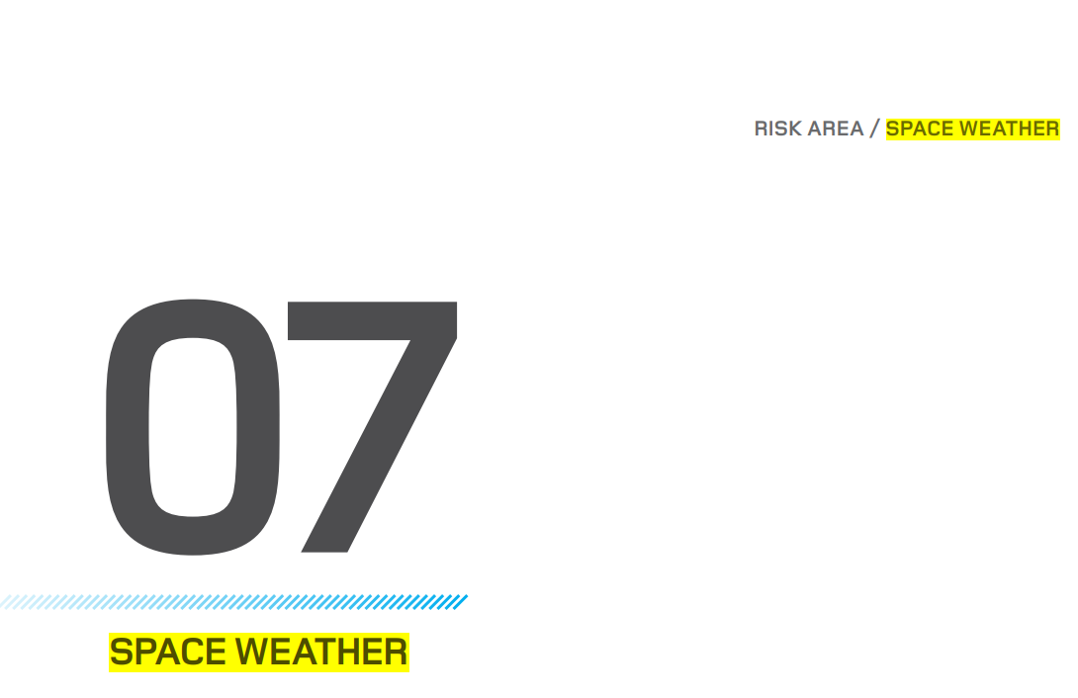
SWx is addressed in several national preparedness plans
2021
2019
2022
2017
2022
2019
2018

Slide 15
Content of the Four Year Plan for WMO Activities related to Space Weather
^{wmo.int}

Slide 16
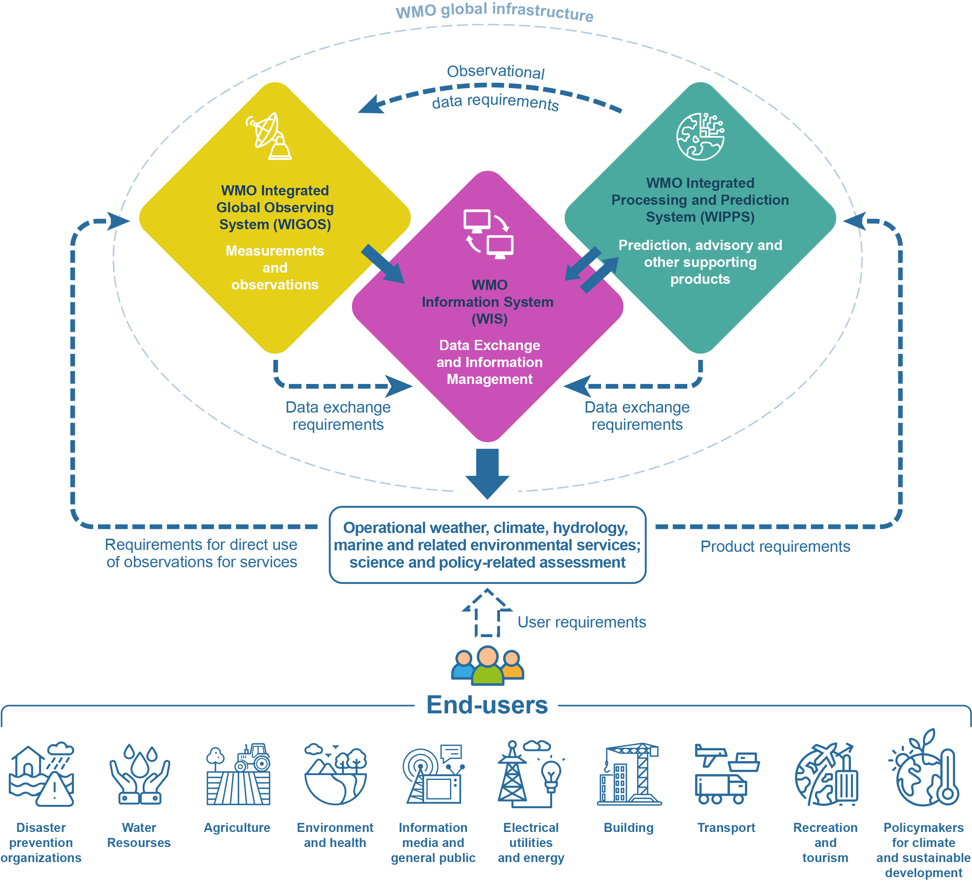
Activities across WMO Infrastructure

Slide 17
WIGOS for Space Weather
Rolling Review of Requirements, Gap Analysis and Statement of Guidance
Integration into OSCAR/Surface and OSCAR/Space
Define attributes for essential Space Weather Observations, for inclusion in the WIGOS Manual and WIGOS Guide
Identification of Core data with respect to the Unified data Policy
Cooperation with ET-RFC on WRC-27 Agenda Item 1.17 (SWx freq. allocations) and ITU Handbook: Use of radio spectrum for Meteorology
These also depend on:
Review applicability and completeness of WIGOS metadata
Consideration of non-NMHS providers and existing networking and standardisation efforts by other International Organisations

Slide 18
WIS and WIPPS for Space Weather
Encourage and guide existing space weather information providers to distribute data and products through the WIS
Investigate processing chains and develop a corresponding approach to integrate (parts of) the processing chain into WIPPS
Define (review) dataformats for distribution of Space Weather data over WIS and requirements for processing for integration in WIS and WIPPS Manuals
These also depend on:
Review applicability and completeness metadata standards
Consideration of non-NMHS providers and existing networking and standardisation efforts by other International Organisations

Slide 19
Activities beyond Infrastructure

Slide 20
Space Weather Services
Continue developing the competency, training and capacity building frameworks for space weather at various qualification levels and for various target audiences, in collaboration with ET-ETC
Continue improving the availability of relevant space weather information to all WMO Members as an integral part of capacity building
Provide guidance for governments concerning their space weather risk assessments
Aviation is a service area where active collaboration between ICAO and WMO is ongoing. ICAO designated 4 global Space Weather Centres in 2018 and their services continue to be in development.

Slide 21
Collaboration with other International Organizations

Slide 22
UN/COPUOS
United Nations Committee for the Peaceful Uses of Outer Space
Expert Group on Space Weather
after conducting a number of surveys to all Member States and with all relevant International Organisations
presented its final report at the Scientific and Technical Subcommittee 59th session in 2022
“towards improved international coordination for space weather services” (A/AC.105/C.1/L.401) with 5 recommendations.

Slide 23
Recommendation 1: UNCOPUOS Letter 1 July 2022
To:
International Space Environment Service (ISES)
World Meteorological Organisation (WMO)
Committee on Space Research (COSPAR)
requesting COSPAR, ISES & WMO lead efforts to improve the global coordination of space weather activities in consultation and collaboration with other relevant actors and international organizations, including COPUOS.
And that member States that are also members of, or are represented at, COSPAR, ISES or WMO engage with those organizations to encourage a response to COPUOS outlining the efforts they will undertake towards the goal of establishing a potential path forward to improve global coordination and collaboration.

Slide 24
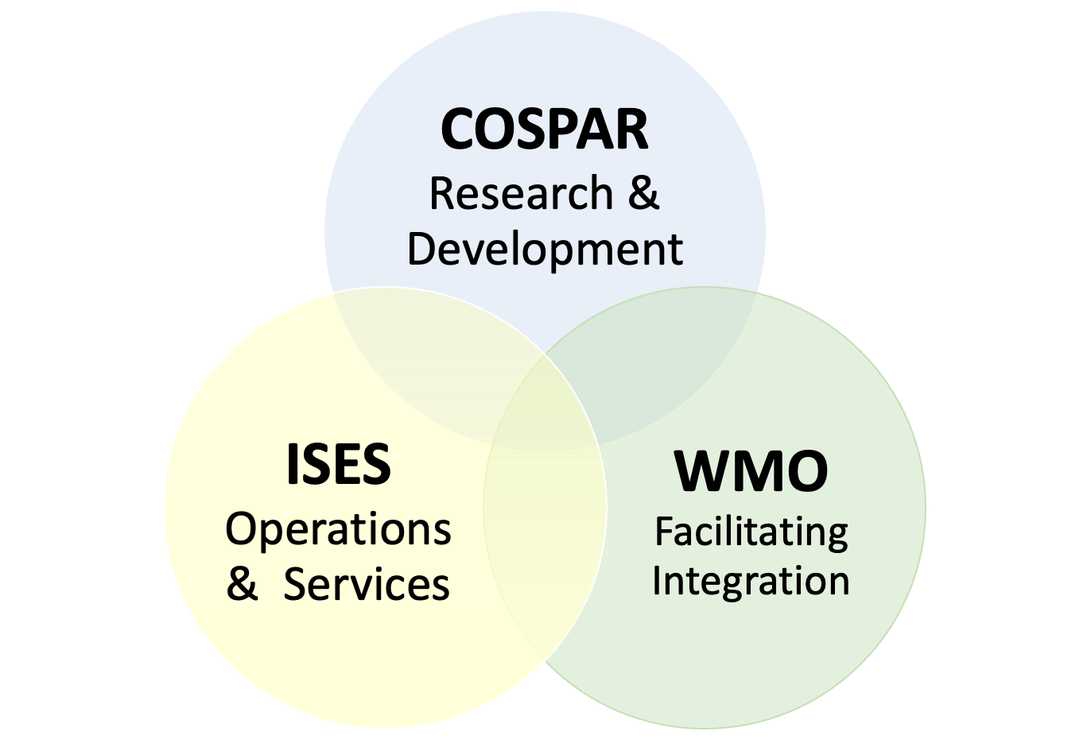
ISES and COSPAR collaboration
ISES
Collection of 22 Space Weather Service providers
Focussed on service provision
WMO collaboration since more than decade
COSPAR Panel on Space Weather
Focussed on Scientific Research
Collaboration through MoU
Capacity development
UNCOPUOS call → Partnership based on core strengths of each

Slide 25
International Space Weather Coordination Forum
Organized jointly with ISES and COSPAR on November 17, 2023, Geneva
Attended by >30 International Organisations (Global, Regional, Space Agencies)
Provide outline of the international Space Weather landscape identifying primary focus of each organization represented in the Forum
Several international organizations to collaborate with for coordinating ground based measurements (IAGA, IAU, URSI)
approach for interfacing with international organizations representing major user groups
approach to alignment with national/regional strategic planning activities and funding programs
plans for pilot projects to advance coordination through collaboration

Slide 26
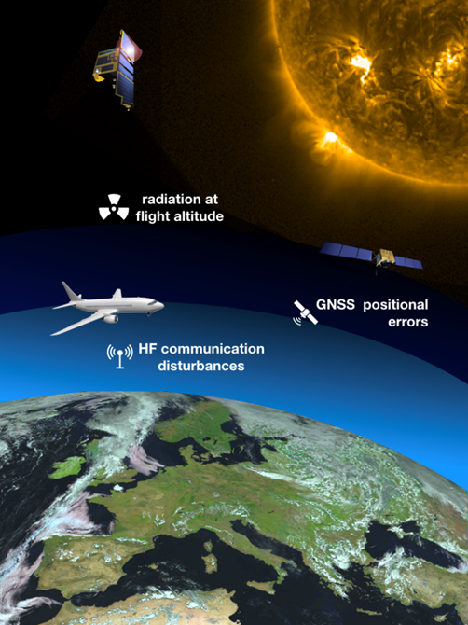
ICAO: Pilot case of close collaboration with a user community
International Civil Aviation Organization
Included SWx in the Aviation Met Information
Designated 4 Global Centres for providing Global SWx services to Aviation
WMO carried out the audit of the candidate Centres (2018)
WMO to support further developments of these services
WMO to integrate required measurement infrastructure into WIGOS
Figure: ESA/Proba-2 & EUMETSAT

Slide 27
Conclusions

Slide 28
Recommendation to EC to
Adopt the Four-year Plan for WMO Activities related to Space Weather 2024-2027;
Request the Commission for Observation, Infrastructure and Information systems to:
Lead the implementation of the activities identified in the FYP2024-2027;
Establish an optimal working and coordinating structure and mechanism:
Addressing all infrastructure components;
Interfacing with user communities of space weather services in collaboration with SERCOM;
Partnering with relevant organizations such as ISES, and COSPAR, as well as other national and international agencies;
Report on the results achieved and make a proposal for future activities in this domain, to be considered by the twentieth World Meteorological Congress.
Urge Members to support the implementation of the FYP2024-2027 with in-kind and/or financial contributions to the Space Weather Trust Fund.

Slide 29
Consider contributing!
If your country has expertise in Space Weather (within the NMHS or outside),
nominate Experts to the Expert network !

Slide 30
Questions?

Slide 31
Thank you.
^{wmo.int}

